Slide 1
Crime Hotspot Detection

Slide 2
Introduction
Aim - The aim of this project is to develop a machine learning model capable of accurately identifying crime hotspots within Los Angeles. By harnessing LAPD crime data, the model will provide actionable insights, enabling the development of targeted security recommendations for clients operating in high-risk areas. Through this endeavor, the project aims to strengthen community safety initiatives, foster collaboration with local law enforcement, and uphold their commitment to data-driven solutions for public safety.

Slide 3
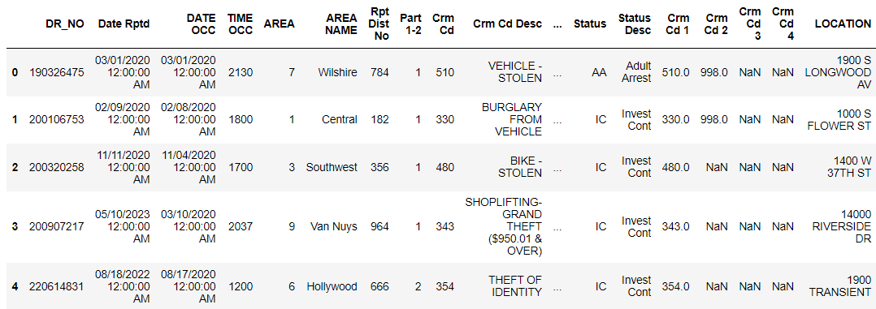
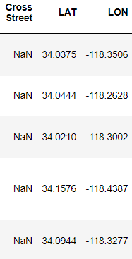
Dataset Collection
Sample dataset in CSV format was available.

Slide 4
Features of Dataset
Given dataset contains different types of columns as follows -
DR_NO – Division of records number: official file no. made up of a 2-digit year, area ID, and 5 digits
Date Rptd – The timestamp of Crime date Reported.
DATE OCC – Date of Crime Occurred.
TIME OCC– Time of Crime Occurred.
AREA- Name of Geographic Area.
Crm Cd Desc– Indicates the Crime Committed.
Victim Age– Victims Age in years.
Victim Sex– Victims sex F: Female, M: Male, X: Unknown.
Weapon Desc– Description of the Weapon Used.
Status Desc– Crime Status.
Location– Street Address of the crime.
Lat/Lon– It gives latitude/Longitude of the Crime.

Slide 5
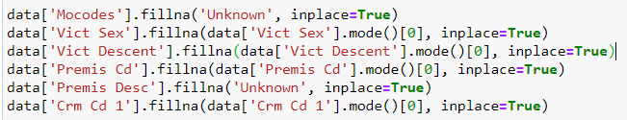
Data Preprocessing
Dealing with the null values – Can significantly impact the performance and accuracy of machine learning models.
Dropping the column – Initially I dropped the following columns:- ‘Weapon Used Cd', 'Weapon Desc', 'Crm Cd 2', 'Crm Cd 3', 'Crm Cd 4', 'Cross Street ‘. They contain a significant number of null values, which could hinder the performance of your machine learning model. When a large portion of a column's data is missing, it may not provide useful information for model training. Additionally, imputing or filling in these missing values could introduce bias or noise, so it's often better to remove such columns to maintain data quality and model accuracy.
Later on the ‘LATITUDE’ and ‘LONGITUDE’ columns were dropped as ‘LONGITUDE’ column contained most of the negative entries.
There are some columns which contain negligible amount of null values, so they are handled by various methods like mean(), mode() or replacing null values by unknown.

Slide 6

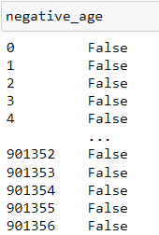
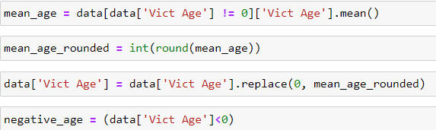
Data Manipulation
The columns 'Date Rptd' and 'DATE OCC' in the data DataFrame are converted into datetime objects using the pd.to_datetime() function from the pandas library.
pd.to_datetime() Function: This function takes a column or series of data and converts it into a datetime64 data type. This allows for easier manipulation, analysis, and comparison of dates.
datetime64 format, you can easily perform operations like extracting the year, month, or day, calculating the difference between dates, filtering data based on a date range, and more.
Column ‘Victim Age’ contained many entries as age equals to ‘0’. So I calculated the mean of the entire column and replaced those 0’s by the mean of their age.

Slide 7
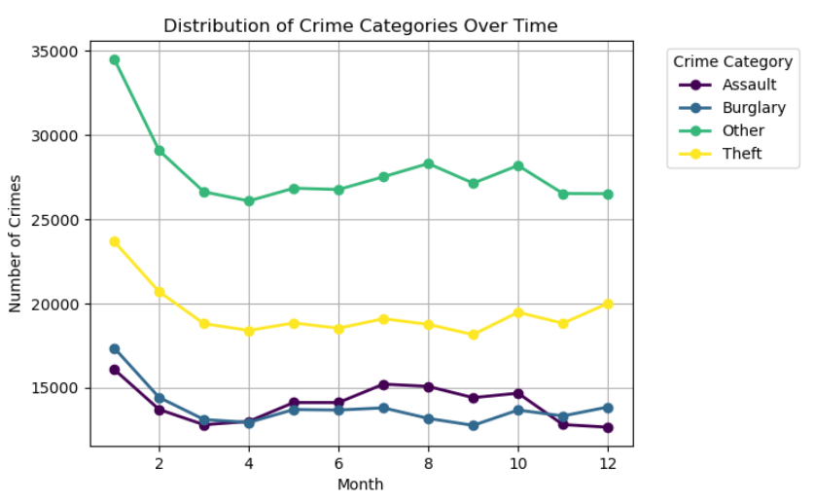
Exploratory Data Analysis
Theft and Other crimes are the most prevalent categories across all months, with thefts remaining fairly consistent between 20,000 to 25,000 incidents after an initial drop in the early months.
Assault and Burglary are less frequent, with fewer than 15,000 incidents each month.
Theft: Shows a sharp decline at the start of the year, after which it stabilizes with minor fluctuations.
Other Crimes: Also declines initially but stabilizes at a higher level compared to theft, with minor fluctuations.
Assault: Remains relatively stable with a slight increase toward the end of the year.
Burglary: Shows a decline initially, followed by a slight increase and eventual stability.
The "Other" crime category appears to be the most common, followed by "Theft," with "Assault" and "Burglary" being less frequent.

Slide 8
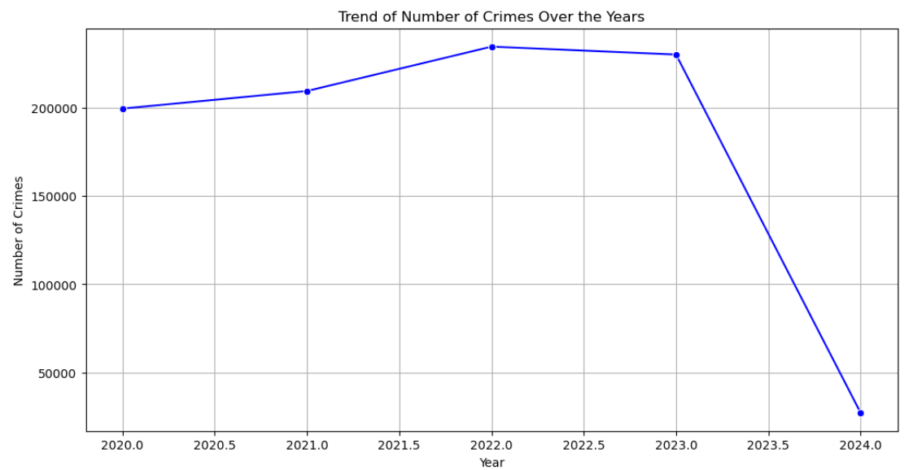
EDA: Trend of Number of Crimes over the Years
(2020-2022): From 2020 to 2022, the number of crimes shows a gradual increase. This indicates that crime rates were rising during this period, reaching a peak in 2022 with the highest number of crimes recorded.
(2022-2023): After peaking in 2022, the crime rate stabilizes slightly in 2023. There is a small decrease, but the overall number of crimes remains high compared to earlier years.
2023-2024): There is a significant drop in the number of crimes from 2023 to 2024. The decline is steep, with the crime rate dropping to its lowest level over the observed period by 2024.
Possible Interpretations: The sharp decline in 2024 could be due to various factors, such as effective law enforcement measures, policy changes, or other socio-economic factors that led to a reduction in crime.
The overall trend shows an increase in crime from 2020 to 2022, followed by a dramatic reduction by 2024.

Slide 9
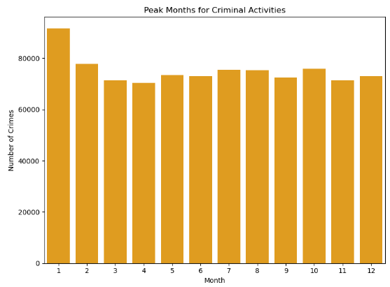
EDA: Peak Months for Criminal Activities
January Spike: January has the highest number of crimes, indicating a peak in criminal activities at the start of the year.
Relatively Even Distribution: From February to December, the number of crimes remains fairly consistent, with only slight variations each month.
No Clear Seasonal Pattern: Apart from the spike in January, there isn't a strong seasonal trend, as the number of crimes does not fluctuate significantly between other months.
criminal activities are the highest in January and remain stable throughout the rest of the year.

Slide 10
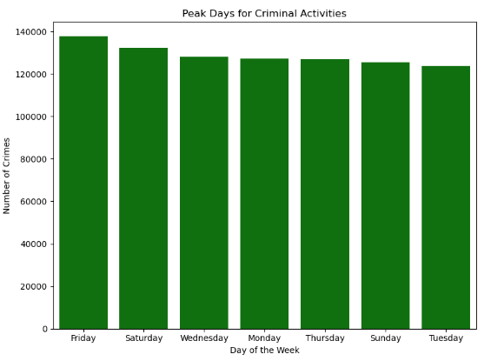
EDA: Peak Days for Criminal Activities
The graph shows how many crimes happen on different days of the week.
Weekends are the busiest: Friday and Saturday have the most crimes.
Weekdays are calmer: Sunday, Monday, Tuesday, and Wednesday have fewer crimes.
Thursday is in the middle: It has a number of crimes between the weekend peak and the weekday low.

Slide 11
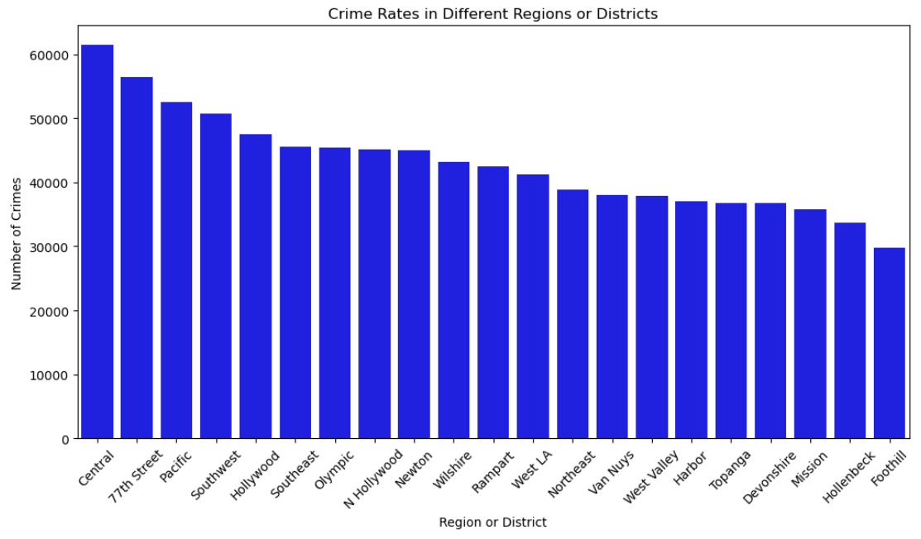
EDA: Crime Rates in different Regions or Districts
Central and Southwest districts have the highest crime rates, with Central having the highest.
Hollywood, Wilshire, Rampart, and Northeast areas also have significantly high crime rates.
West Valley, Topanga, Van Nuys, Mission, and San Fernando Valley regions have comparatively lower crime rates.
There's a considerable disparity in crime rates between different areas.

Slide 12
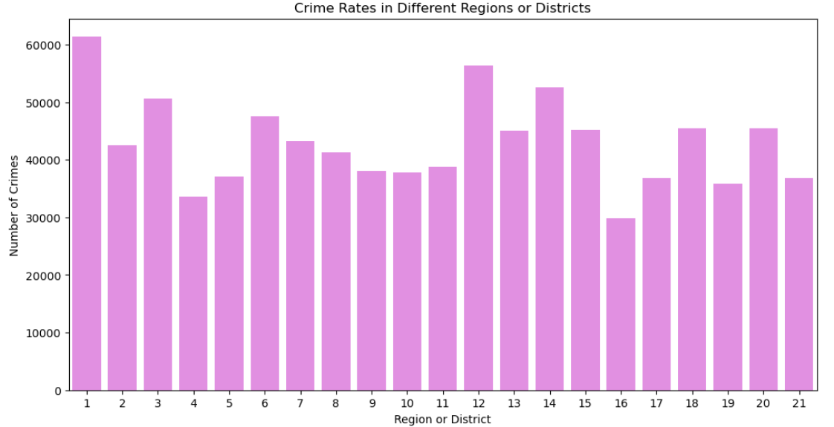
EDA: Crime Rates in different Regions or Districts
Region 1 has the most crimes, with over 60,000 incidents, making it the most crime-prone area.
Crime rates vary significantly across regions. Some regions, like 12 and 14, also have high crime rates, while others, like 7 and 16, have relatively lower rates.
Many regions have a crime count between 30,000 and 50,000, indicating a moderate level of crime activity across these areas.

Slide 13
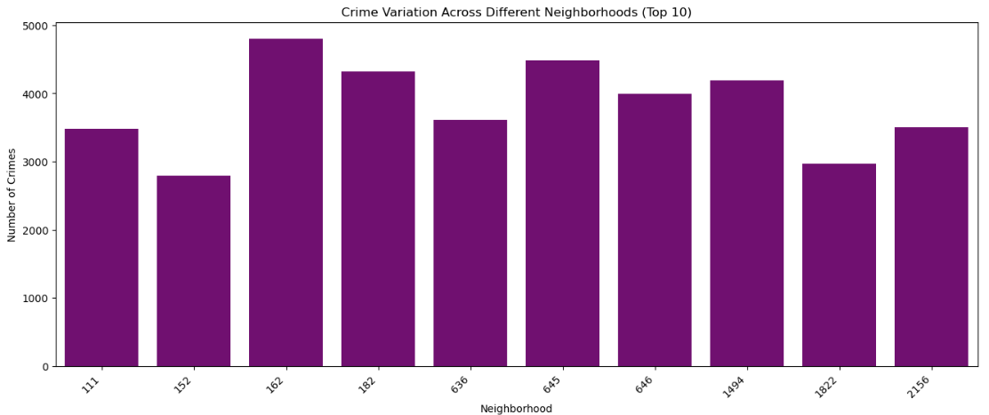
EDA: Number of crimes across different neighborhoods
Crime Rate Disparity: There's a significant difference in crime rates between neighborhoods. The top neighborhood by crime rate has over 10 times the crime rate of the lowest.
Top Crime Areas: The last few neighborhoods listed appear to have the highest crime rates, with numbers exceeding 1000 incidents.
Data Limitation: The graph only presents the top 10 neighborhoods by crime rate, so the overall crime picture is incomplete.

Slide 14
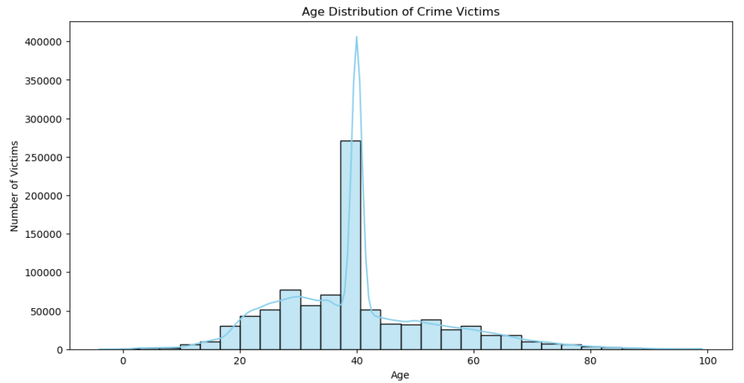
EDA: Age Distribution of Crime Victims Graph
Peak Victimization: The highest number of crime victims falls within the age range of 20 to 40 years.
Decreasing Trend: The number of victims steadily decreases with increasing age, after the peak in the 20-40 age group.
Lower Incidence: The youngest and oldest age groups (below 20 and above 80) have significantly lower victimization rates.

Slide 15
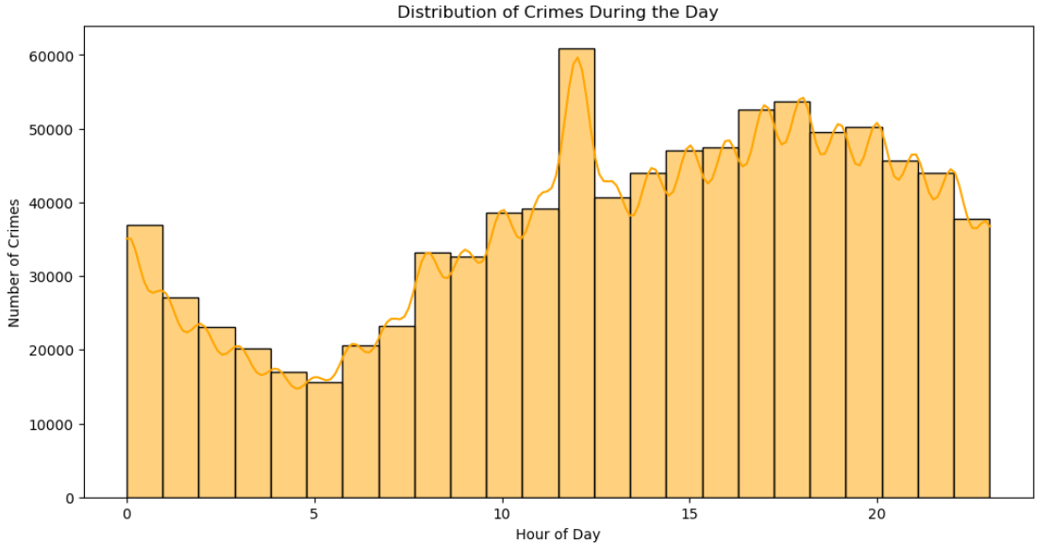
EDA: Distribution of Crimes During the Day
Peak Crime Hours: The highest number of crimes occurs between 8 PM and 10 PM.
Decreasing Trend: The number of crimes decreases steadily as the day progresses towards morning hours.
Lowest Crime Rate: The lowest crime rates are observed during the early morning hours (before 6 AM).

Slide 16
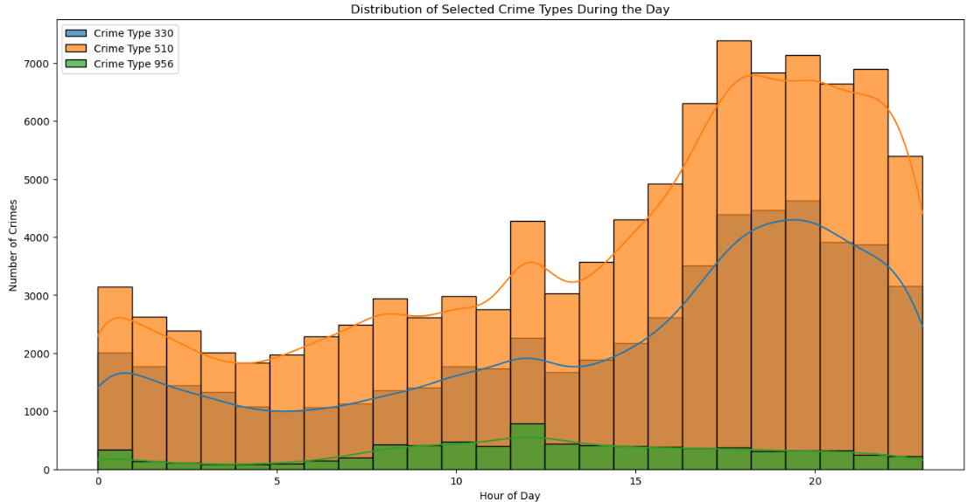
EDA: Distribution of Selected Crime Types During the Day
Crime Type 956 consistently has the highest number of occurrences across all hours of the day.
Crime Type 330 shows a peak in incidents around the 10-hour mark and then gradually decreases.
Crime Type 510 has a relatively low number of occurrences throughout the day.
Overall Pattern: There's a general trend of increasing crime incidents as the day progresses, with a potential peak around the 10-hour mark for certain crime types.

Slide 17
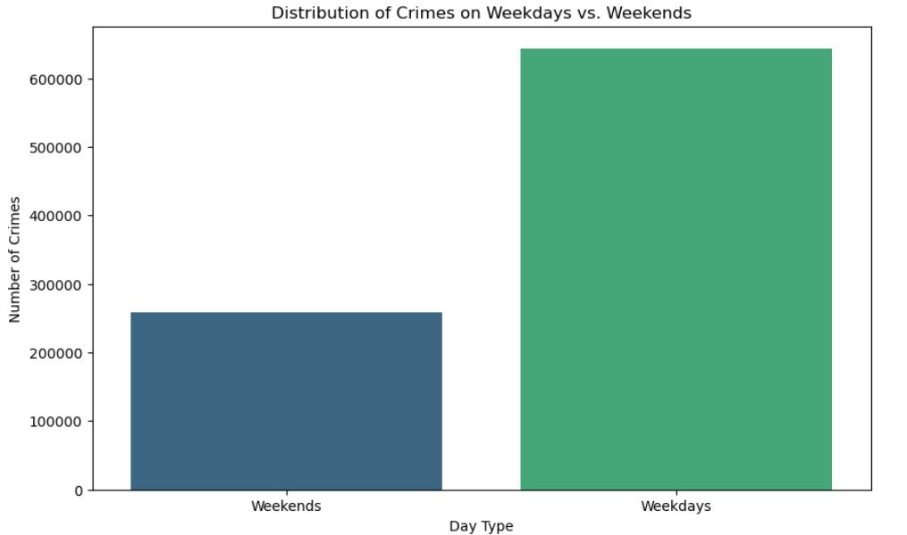
EDA: Crime Distribution on Weekdays vs. Weekends
Higher Crime on Weekends: The graph indicates that there is a significantly higher number of crimes reported on weekends compared to weekdays.
Crime Rate Disparity: The difference in crime rates between weekdays and weekends is substantial, suggesting a distinct pattern.

Slide 18
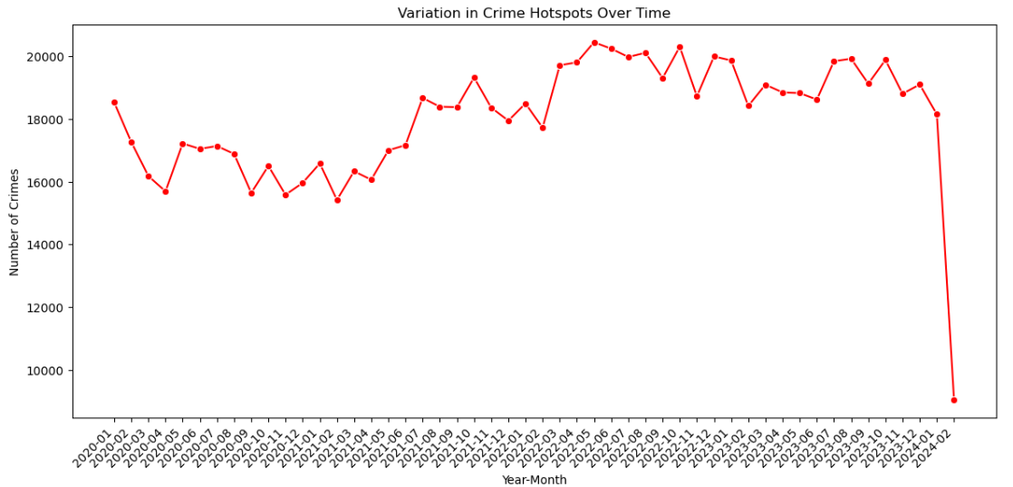
EDA: Crime Hotspots Over Time
Crime Rate Fluctuations: The number of crimes (represented on the y-axis) varies significantly over the plotted period. There are peaks and troughs indicating periods of heightened and reduced criminal activity.
Time Period Analysis: The x-axis displays a timeline, allowing for the identification of specific periods with higher or lower crime rates. For instance, there seems to be a notable increase in crime around the "22-02" period.
Data Granularity: The graph provides data at a monthly level, enabling the observation of seasonal or cyclical patterns in crime rates.

Slide 19
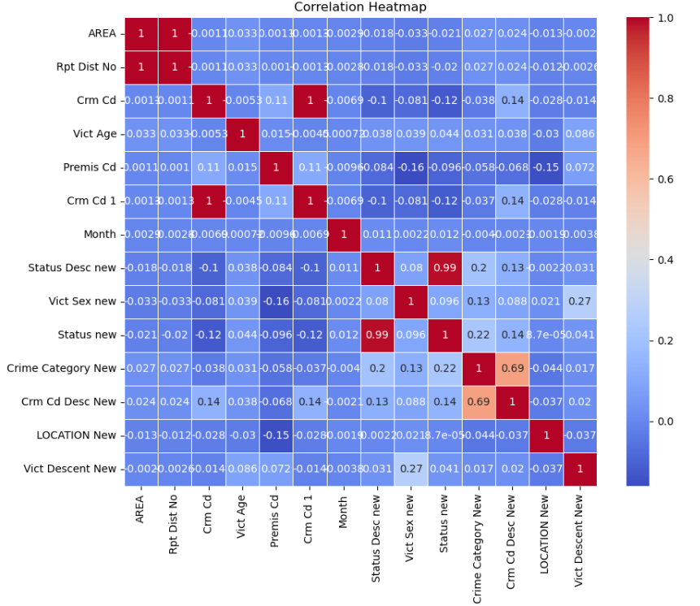
Correlation Heatmap
High Positive Correlations:
Status new and Status Desc new: 0.99
Crm Cd Desc New and Crime Category New: 0.69
Moderate Positive Correlations:
Vict Descent New and Vict Sex new: 0.27
Crime Category New and Status new: 0.22
Crime Category New and Status Desc new: 0.20
Low to Negligible Correlations:
Most other correlations between attributes are close to zero, indicating very weak relationships.

Slide 20
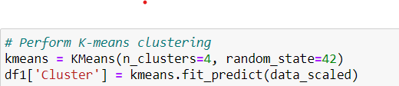
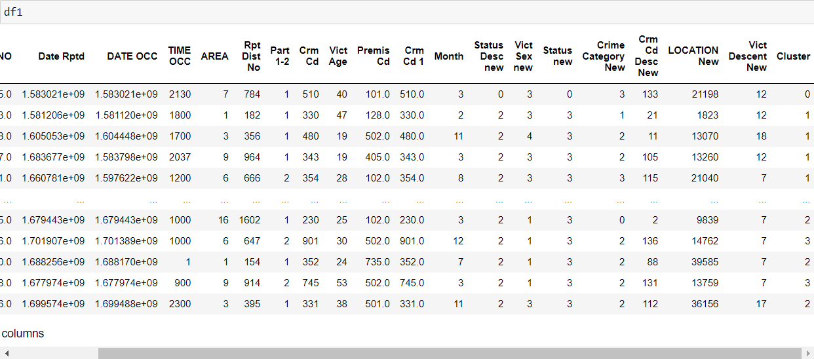
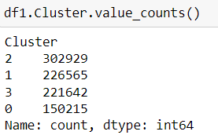
K-means Model To Form Clusters
K value = 4
Cluster column is added in the dataframe.
Cluster 2 ha maximum items and cluster 0 has minimum items.

Slide 21
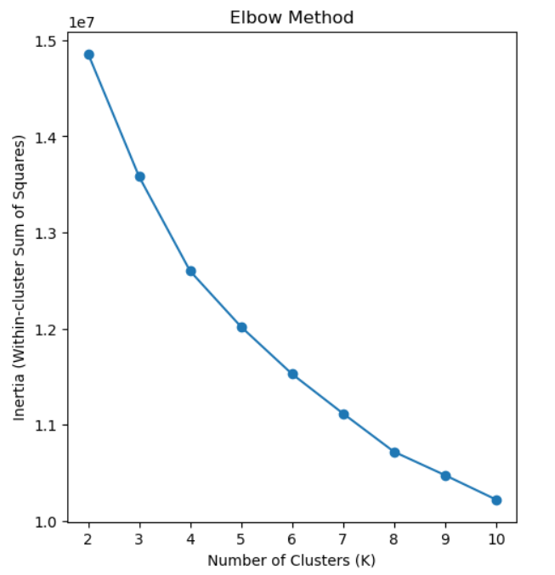
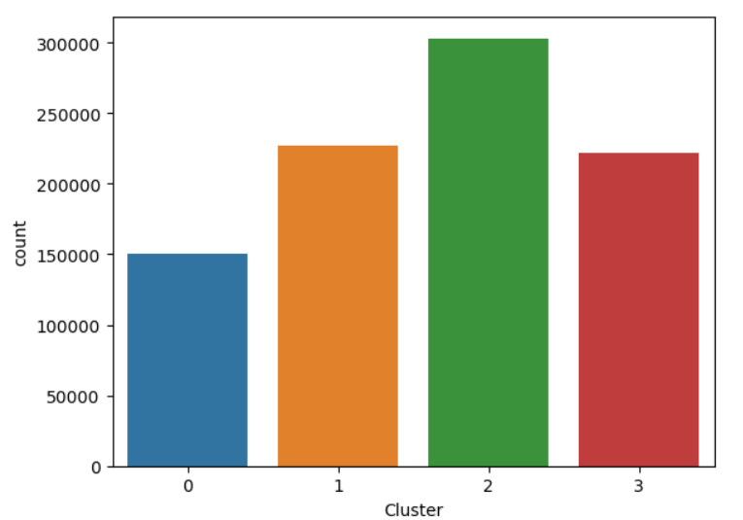
Visualization of Clustered Dataframe
K Value is 4
Using the Elbow Method

Slide 22
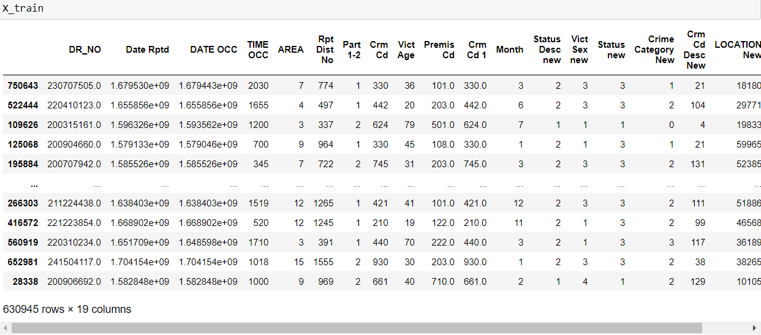
Predictive Modelling
Data is split as 70% for training and 30% for testing.
( Tried 80% and 20% split, minimal changes in the accuracy.)

Slide 23
Evaluation Metrics
Accuracy: Measures how many times a model made a correct prediction across the entire dataset.
Precision: Quantifies the number of positive class predictions that actually belong to the positive class.
Recall: Quantifies the number of positive class predictions made out of all positive examples in the dataset.
F1 Score: - It is calculated as the harmonic mean of precision and recall.
MAE (Mean Absolute Error) - is the average error when making a prediction with the model. It is more robust to data with outliers
MSE ( Mean Squared Error) - It is the average squared difference between the estimated values and the actual value.
R-Squared – It shows how well your predictions approximate the real data points.

Slide 24
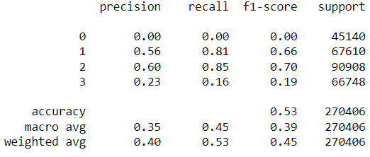
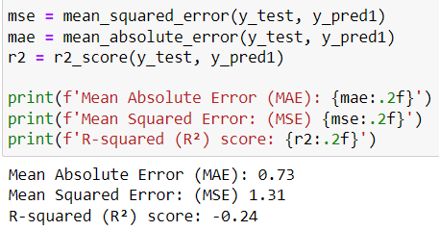
Logistic Regression
Logistic Regression - Logistic regression is a statistical method used to predict the probability of a certain outcome or event happening. logistic regression creates an S-shaped curve (called the sigmoid curve) that helps in understanding how the probability of the outcome changes with the different factors.
Results -

Slide 25
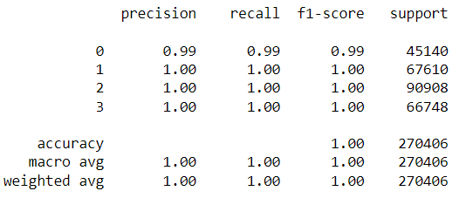
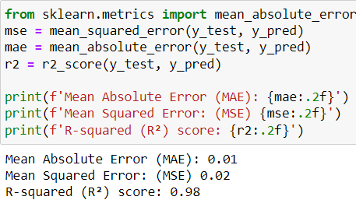
Decision Tree Classifier
Decision Tree Classifier - A Decision Tree Classifier is a method used to make predictions based on a series of decisions, much like how you might make a decision by asking a series of yes or no questions. This method is especially useful for classification problems where you want to categorize data into different groups, like spam or not spam, disease or no disease, etc. The "tree" structure makes it easy to understand and visualize how decisions are made.
Results -

Slide 26
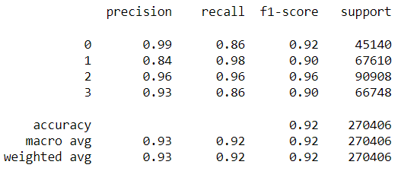
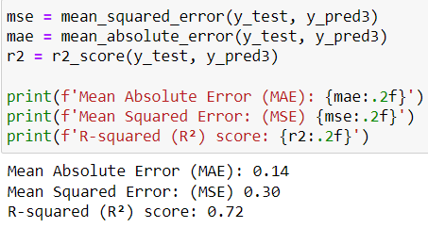
Ada-Boost
Ada-Boost - AdaBoost (Adaptive Boosting) is a machine learning algorithm used to improve the performance of other machine learning algorithms, usually simple ones called "weak learners." A weak learner is a model that performs slightly better than random guessing, like a simple decision tree that might make a lot of mistakes on its own.
Results -

Slide 27
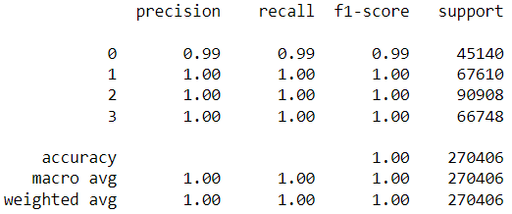
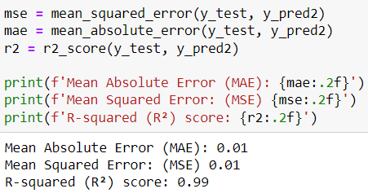
Random Forest Classifier
Random Forest Classifier - is a machine learning algorithm that uses multiple decision trees to make predictions. It’s like a collection of decision trees, where each tree is trained on a slightly different part of the data. The idea is that by combining the predictions from many trees, the model becomes more accurate and less likely to make errors.
Results -

Slide 28

Conclusion
Successfully developed a predictive model for Crime Hotspot Detection with Random Forest achieving the best performance.

Slide 29
Thank You!

